Slide 1
EECE 229 Introduction to Digital Systems

Slide 2
Chapter 6
Registers and Counters

Slide 3
Overview
Registers
4-bit register
4-bit shift register
Serial adder
Universal shift register
Counters
Ripple counter
Synchronous counter

Slide 4
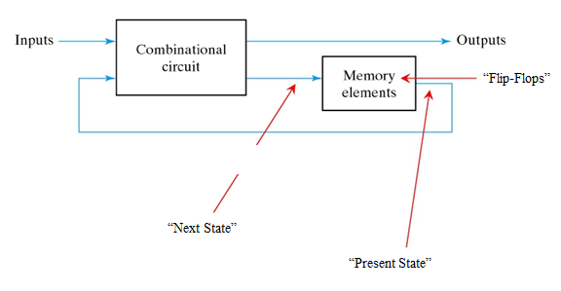
Registers and Counters
A clocked sequential circuit consists of a group of flip-flops and combinational gates connected to form a feedback path.
Circuits that include flip-flops are usually classified by the function they perform.
Two such circuits are registers and counters.

Slide 5
registers

Slide 6
Registers
A register is a group of flip-flops. Each flip-flop is capable of storing one bit of information.
An n-bit register consists of a group of n flip-flops capable of storing n bits of binary information.
A register may have combinational gates that perform data processing task.
The flip-flops holds binary information and the gates determine how the information is transferred into the register.

Slide 7
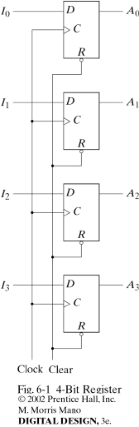
4-bit register
A register constructed with four D flip-flops.
The common clock input triggers all flip-flops on positive edge of each pulse, and binary data available at four inputs are transferred into the 4-bit register.
The clear input R, resets inputs of all flip-flops. R=0, the registers are cleared to all 0’s. R=1 is maintained during normal clocked operations.

Slide 8
4-bit register
The clock must be inhibited from the circuit if the content of the register must be left unchanged.
An enable gate can be used to control the clock input signal.
However, the insertion of logic gates with clock pulses brings propagation delays and may cause system go out of synchronism!
It is advisable to control inputs rather than clock!

Slide 9
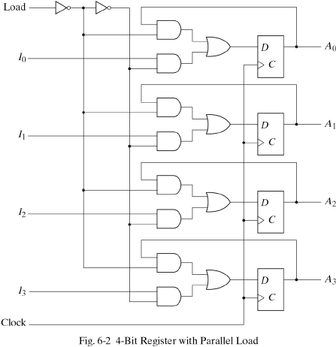
Registers with Parallel Load
Load control input to the register determine the action to be taken with each clock pulse.
If “Load” =1, the register will load from the inputs.
If “Load” =0, the register will hold the stored value by connecting the output of flip-flop to present state.
The load input controls the next clock pulse will accept new information or leave the information in the register intact.
Notice that the register
will load from the inputs
on every clock pulse

Slide 10
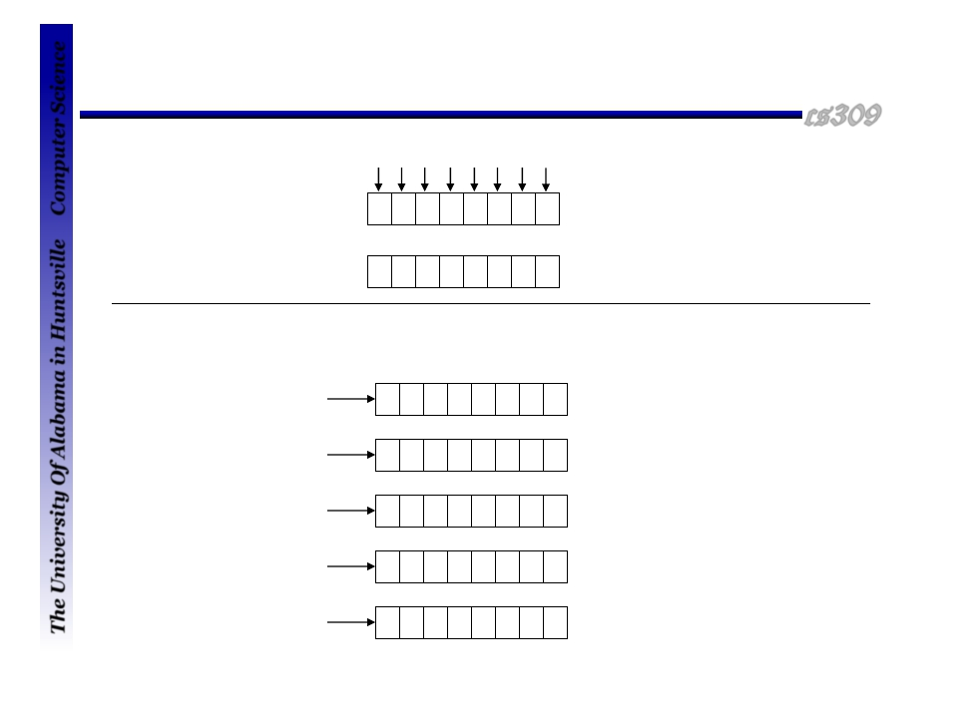

Serial versus parallel load
Computer Science
Parallel load
0 0 1 0 1 1 0 0
0 0 1 0 1 1 0 0
0
0 0
1 0 0
1 1 0 0
After clock pulse 1
After clock pulse 1
After clock pulse 2
After clock pulse 3
After clock pulse 4
Serial load
0 0 1 0 1 1 0 0
0 0 1 0 1 1 0
0 0 1 0 1 1
0 0 1 0 1
0 0 1 0
The University Of Alabama in Huntsville

Slide 11
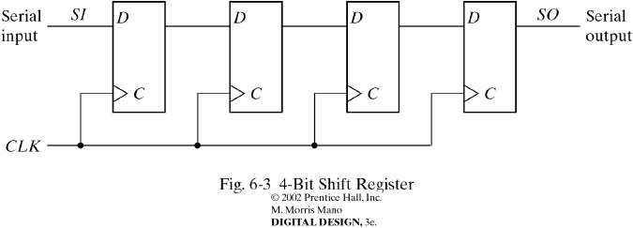
4-bit shift register
A shift register consists of a chain of flip-flops in cascade, with the output of one flip-flop connected to the input of the next flip-flop.
Serial input controls what goes into the leftmost flip-flop during the shift.
Serial output controls what goes out from the rightmost flip-flop during the shift.
Shift operation can be controlled through D inputs of the flip-flops.

Slide 12
Shift registers
The idea
0 0 1 0 0 0 0 0
bit ready to
be “shifted in”
0
“right shift”
0 0 0 1 0 0 0 0
“left shift”
bit that was
“shifted out”
0
1001
Shift left one bit?
0
0 0 1 0 0 0 0 0
10010

Slide 13
Serial Transfer
A digital system is said to operate in a serial mode when information is transferred and manipulated one bit at a time.
This is in contrast to parallel transfer where all the bits of the register are transferred at the same time.
The serial transfer can be done with shift registers.

Slide 14
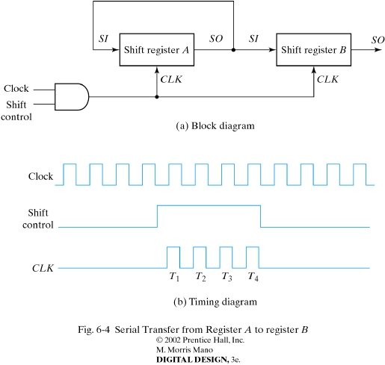
Serial transfer
Serial transfer of information from register A to register B.
The serial output (SO) of register A is connected to serial input (SI) of register B.
SO is connected to SI in register A to prevent information loss.
Each rising edge under shift control (1) will cause a shift in both registers.

Slide 15
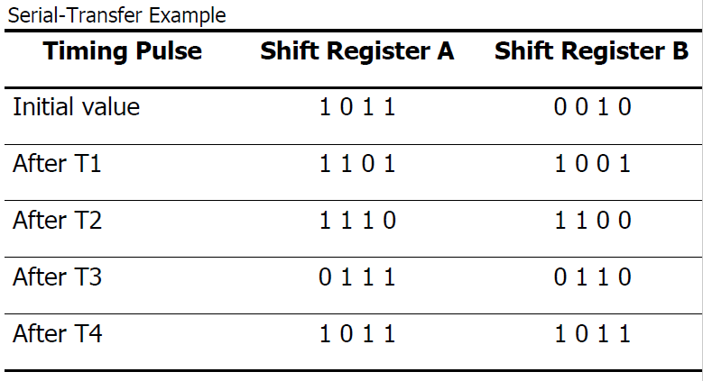
Serial transfer

Slide 16
Serial Adder
Operations in digital computers are usually done in parallel because this is a faster mode of operation.
Serial operations are slower, but have the advantage of requiring less equipment.
The two binary numbers to be added serially are stored in two shift registers.
Bits are added one pair at a time through a single full adder.

Slide 17
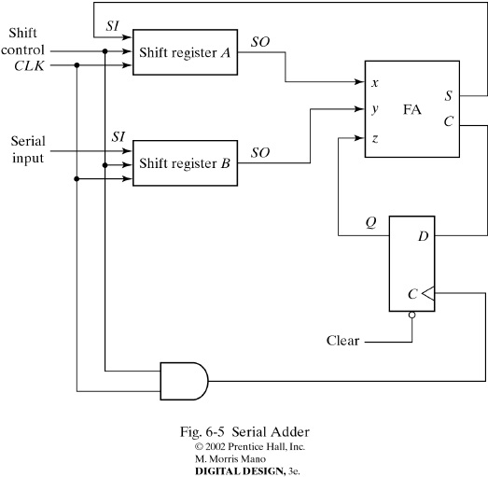
Serial Adder
Register A holds the augend, and register B holds the addend, the carry flip-flop is cleared to 0.
The carry out of the full adder is transferred to a D flip-flop.
The output of the D flip-flop is then used as carry input for the next pair of significant bits.

Slide 18
Universal Shift Register
A parallel-load control to enable a parallel transfer and the n input lines associated with the parallel transfer.
n parallel output lines.
A control state that leaves the information in the register unchanged in the presence of the clock.
If the register has both shifts and parallel load capabilities, it is referred to as a universal shift register.

Slide 19
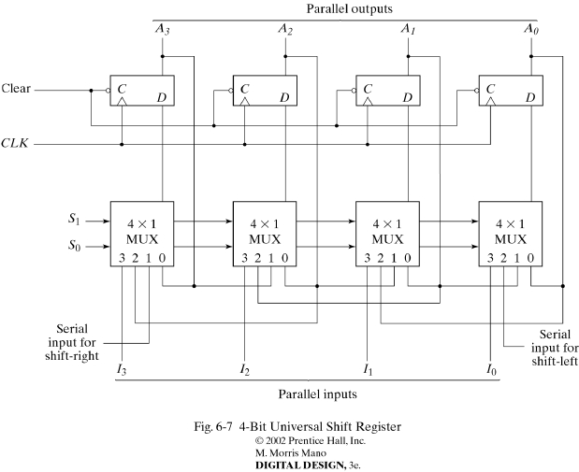
Universal Shift Register
mode control
S1 S0 Operation
------------------------
0 0 no change
0 1 Shift right
1 0 Shift left
1 1 Parallel load

Slide 20
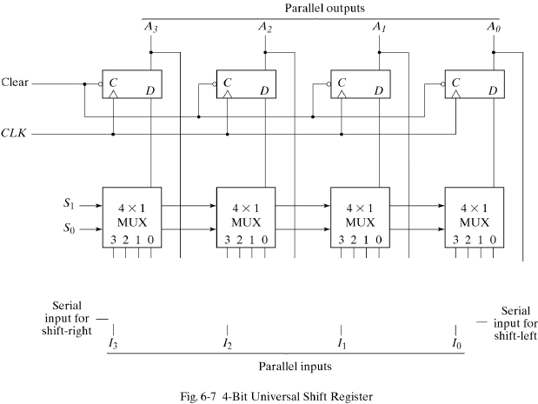
Operation Diagrams
S1 S0 Operation
------------------------
0 0 no change
0 1 Shift right
1 0 Shift left
1 1 Parallel load

Slide 21
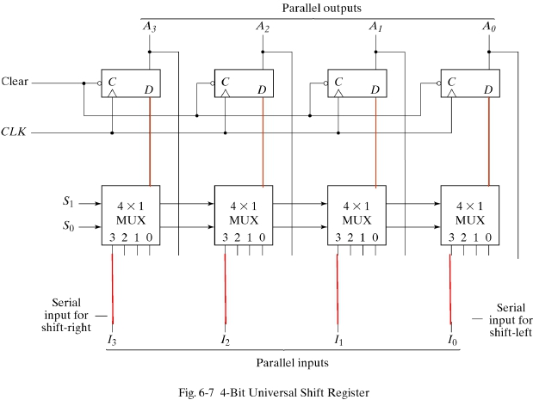
Active lines for Parallel Load
S1 S0 Operation
------------------------
0 0 no change
0 1 Shift right
1 0 Shift left
1 1 Parallel load

Slide 22
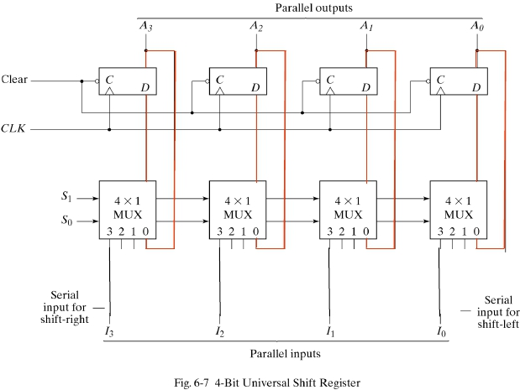
Active lines for No change
S1 S0 Operation
------------------------
0 0 no change
0 1 Shift right
1 0 Shift left
1 1 Parallel load

Slide 23
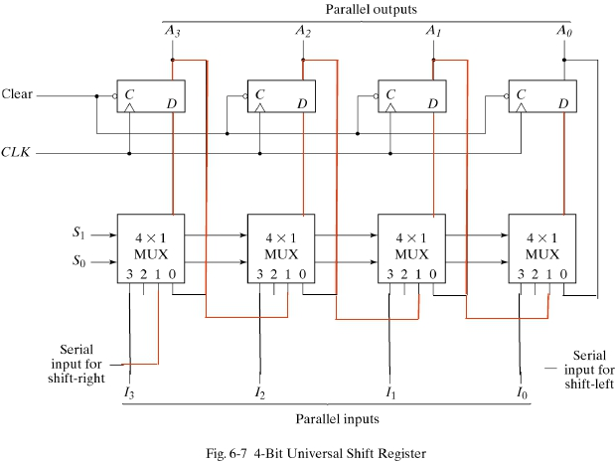
Active lines for Shift Right
S1 S0 Operation
------------------------
0 0 no change
0 1 Shift right
1 0 Shift left
1 1 Parallel load

Slide 24
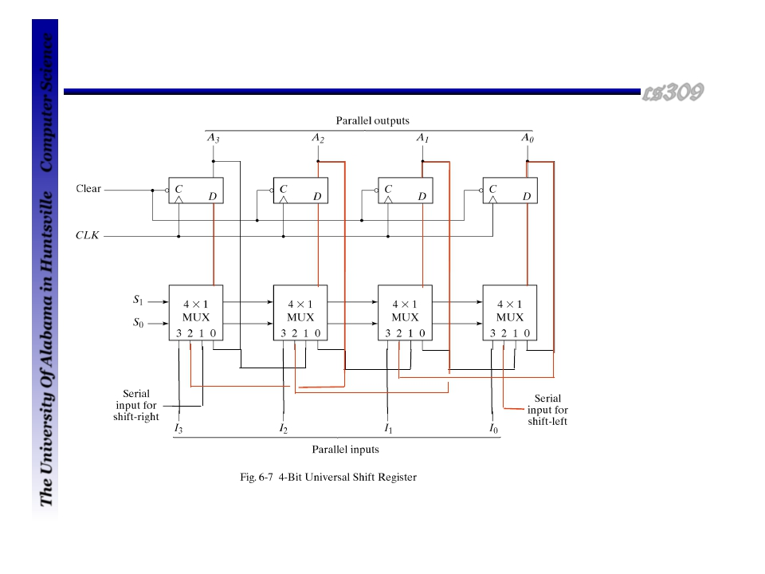
Active lines for Shift Left
cs309
Computer Science
S1 S0 Operation
------------------------
0 0 no change
0 1 Shift right
1 0 Shift left
1 1 Parallel load
The University Of Alabama in Huntsville

Slide 25
Counters

Slide 26
Counters
A register that goes through a prescribed sequence of states upon the application of input pulse is called a counter.
A counter that follows the binary number sequence is called a binary counter.
Counters are available in two categories
Ripple counters
Synchronous counters

Slide 27
Counters
Ripple counter
The flip-flop output transition serves as a source for triggering other flip-flops.
The C input of some or all flip-flops are triggered not by the common clock pulse.
Synchronous counter
The C input of all flip-flops receive the common clock.

Slide 28
Binary Ripple Counter
Consists of a series connection of complementing flip-flops.
The output of each flip-flop is connected to the C input of the next flip-flop in sequence.
The flip-flop holding the last significant bit receives the incoming count pulse.
A complementing flip-flop can be obtained from:
JK flip-flop with the J and K inputs tied together
T flip-flop
D flip-flop with the complement output connected to the D input

Slide 29
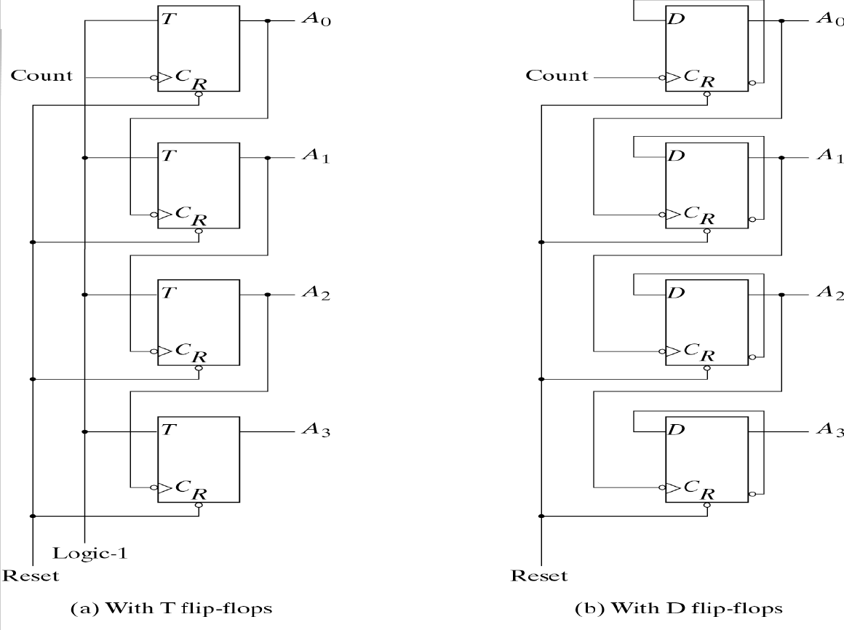
Binary Ripple Counter
In a ripple counter, the clock (count) pulse is applied to the first stage only. The change in stage “n” triggers the clock pulse for stage “n+1”.
T=1, causing the each flip-flop complement the present state.
D input is always the complement of the present state.
FF’s are triggered by a 1->0 transition on the clock input

Slide 30
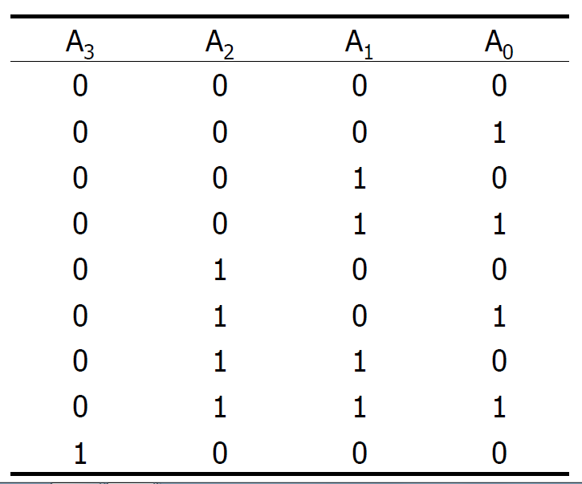
Binary Ripple Counter
The least significant bit A₀ is complemented with each count pulse input.
Every time that A₀ goes from 1 to 0, it complements A₁.
Every time that A₁ goes from 1 to 0, it complements A₂.
Every time that A₂ goes from 1 to 0, it complements A₃.

Slide 31
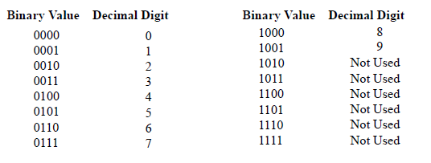
BCD Ripple Counter
A decimal counter follows a sequence of ten states and returns to 0 after the count of 9.
This is similar to a binary counter, except that the state after 1001 is 0000.
The operation of the counter can be explained by a list of conditions for flip-flop transitions.

Slide 32
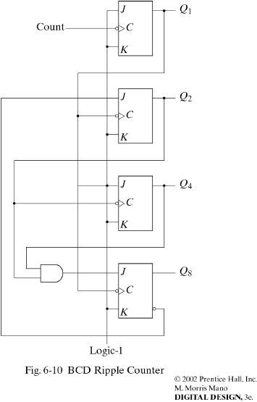
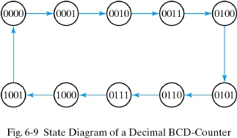
Decade Ripple Counter
State Diagram of a Decimal BCD Counter
BCD Ripple Counter

Slide 33
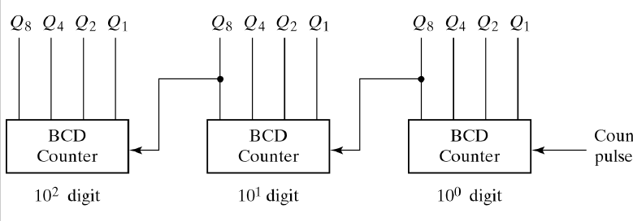
BCD Ripple Counter
The BCD counter of is a decade counter.
To count in decimal from 0 to 999, we need a three-decade counter.
Multiple decade counters can be constructed by connecting BCD counters in cascade, one for each decade.

Slide 34
Synchronous Counters
Synchronous counters are different from ripple counters in that clock pulses are applied to the inputs of all flip-flops.
A common clock triggers all flip-flops simultaneously rather than one at a time in succession as in a ripple counter.

Slide 35
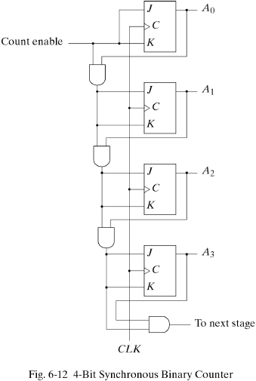
Synchronous Counters
In a synchronous counter
the clock (count) pulse is
applied to all stages at once
4-Bit Synchronous Binary Counter

Slide 36
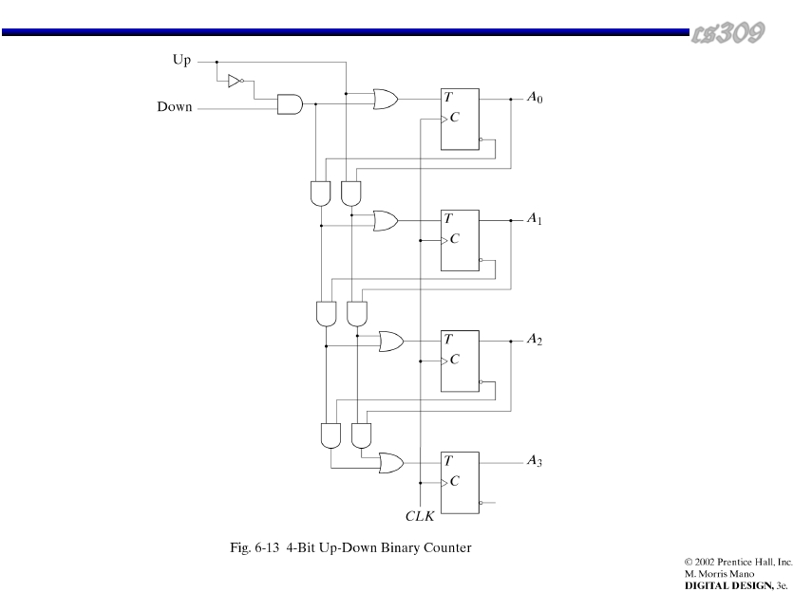
Up-Down Counter
The two operations can be combined in one circuit to form a counter capable of counting up or down.
It has an up control input and down control input.
4-Bit Synchronous Up-Down Binary Counter

Slide 37
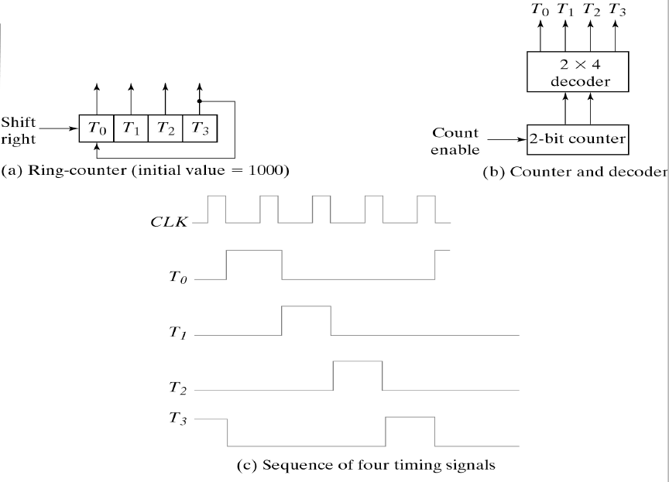
Ring Counter
A ring counter is a circular shift register with only one flip-flop being set at any particular time, all others are cleared.
The single bit is shifted from one flip-flop to the next to produce the sequence of timing signals.
The decoder decodes the four states of the counter and generates the required sequence of timing signals.

Slide 38
Conclusion
Know what is a register
Understand the difference between parallel load and serial load for register
Know circuits of a 4-bit register
Know the 4-bit shift register
Know the serial transfer example
Know universal shift register
Know binary ripple counter and understand the circuits
Know BCD ripple counter and Up-Down counter
Know the difference between ripple counter and synchronous counter

Slide 39
Reference:
Some of the artwork and graphs are from the following books:
1. Fundamentals of Digital Logic with Verilog design, by Stephen Brown and Zvonko Vranesic, 3rd edition, McGraw Hill
2. Digital Design, 5th Edition, By M. Morris Mano, Michael D. Ciletti, Prentice Hall.

